Slide 1
KNN K – nearest neighbours
Set up T4 Machine – 15 min
Progress check – 5 min
Q&A – 10 min
KNN hands on – 1.30 min
Assignment – 5 min
Notes:
If finding hard to learn concepts, complete all exercises in book Learning Python 3 hard way

Slide 2
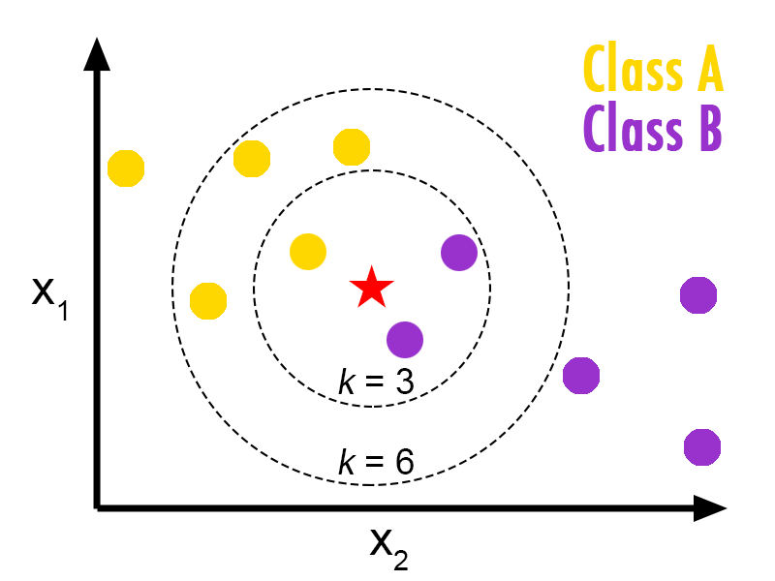
What is KNN

Slide 3
How distance is calculated
identifier | class name | args | distance function
“euclidean” | EuclideanDistance |  | sqrt(sum((x - y)^2))
“manhattan” | ManhattanDistance |  | sum(|x - y|)
“chebyshev” | ChebyshevDistance |  | max(|x - y|)
“minkowski” | MinkowskiDistance | p | sum(|x - y|^p)^(1/p)
“wminkowski” | WMinkowskiDistance | p, w | sum(|w * (x - y)|^p)^(1/p)

Slide 4
KNN Algo in Sk learn KNeighborsClassifier(n_neighbors=5, weights='uniform', algorithm='auto', leaf_size=30, p=2, metric='minkowski', metric_params=None, n_jobs=None, **kwargs)
n_neighbors = k
Weights – uniform, distance - weight points by the inverse of their distance.
Algorithm - 'auto', 'ball_tree', 'kd_tree', 'brute'
leaf_size - Leaf size passed to BallTree or KDTree
P – Power parameter
Metric – minkowski or Euclidean
Notes:
https://medium.com/machine-learning-101/k-nearest-neighbors-classifier-1c1ff404d265
https://scikit-learn.org/stable/modules/generated/sklearn.neighbors.KNeighborsClassifier.html
https://scikit-learn.org/stable/modules/generated/sklearn.neighbors.DistanceMetric.html

Slide 5
Algorithms What is suitable when
Brute force performs worst when there are large dimensions and large training set.
K-D tree performs well enough when D <20. With larger D it again takes longer time. This is known as “curse of dimensionality”.
Ball tree is optimal when D is large
Notes:
KD tree explaination: https://ashokharnal.wordpress.com/2015/01/20/a-working-example-of-k-d-tree-formation-and-k-nearest-neighbor-algorithms/

Slide 6
Assignment – Due by 20th May
Implement KNN in digit prediction and report score and time difference

